Slide 1
Rapid Analysis-Automation For Developers (RAAD)
PI – Joseph (Joe) Tarango
Collaborator/Sponsor – Jim Baca
Notes:
Hello Everyone, Today we are here to present the pathfinding proposal for RAAD. RAAD is rapid analysis and automation for developers. The work presented today builds on previous telemetry, machine programming, data lake, customer engineering, and various working groups. The effort is planned to lead by Jim and myself.

Slide 2
STG Pathfinding Update
Pathfinding Project Name | Rapid Analysis-Automation For Developers (RAAD)
Project Timeline | Approval + 5 Quarters
Co-Travelers | Analysis COE comprised of: NSG, Intel Labs(IL), IAGS Tools, IT infrastructure, Validation, and CAPA Universities
Targeted Product Intercept | Lead trunk program at PF-Exit (Expect: Huntsdale and Lakestream)
Recommender - the PI | Joe Tarango
Agreers | DND (Marcus Junered), IL Sr. Fellow (Pradeep Dubey)
Performers – PI plus team | STG: Joe Tarango, Jim Baca, Andrea Chamorro, Tyler Woods, Daniel Garce, PanteA Zardoshti DND: Alberto Sanchez (Triage Tool), Andy Sainz (Validation) Intel Labs (Machine Programming – MP): Justin Gottschlich + team NSG Data Lake: Kathryn Carruthers IT Data Lake/Infrastructure: Nitin Jain IAGS: Paul Petersen
Inputs | Customers (Marcus, Robbie, Tim Rothman, Justin, Paul, Charles, Kathryn)
Decider | Frank Hady
Notes:
Note: Pathfinding inline with TSLRP “Rapid Analysis using Telemetry for Enhanced (RATE) Customer Experience” and Intel Labs/IASG/NSG joint “Machine Learning Research Proposal”
On this slide we can see the plan for the pathfinding it to be conducted over 4+ quarters. The travelers for collaboration are from Intel Labs, execution, customer engineering, IT, and universities. A significant note is Senior Fellow Predeep Dubey from Intel labs since he sees strong promise for the future of Intel.
I would like to thank everyone at this time for the input into the construction of the content; specifically, Sanjeev, Jim, Frank, Robbie, Justin G., and others I cannot remember at the moment. Your guidance in the focusing on the topic has influenced a comprehensive approach.

Slide 3
Summary - Rapid Analysis-Automation For Developers (RAAD)
Topic | Summary of slides presented
Environment | Telemetry capability now available (2019) across all enterprise SATA and NVMe SSDs (NAND-Optane™). Drive information available through our translation, triage, and simulation tools. AEs embrace Telemetry/Triage to rapidly provide issue likely root cause back to customers (weeks to days). This acceleration has identified gaps in domain knowledge in order to quickly confirm root cause, alleviate, and mitigate anomalies/issues. Debug remains slow in assert/perf/power failures is limited (~6.5 days to resolve a bug spread over weeks).
Opportunities addressed | Expedite debug velocity: Automate expert contextual analysis to identify/root cause problems based on Telemetry (via SW outside of SSD) Detect and Predict drive behaviors: Extract Signatures of Telemetry data to detect & predict anomalous drive behavior (via SW outside of SSD)
Pathfinding Questions | Using telemetry, fw-sources, and MP engine(s) to evaluate a SSD bug, is it possible to deliver automatically generated expert domain analysis (expertly evaluate SSD fw bug)? Focus on NVMe SSD FW Customer Asserts (based on top 2 customer asserts already identified): DF049: Wear leveling issue and MB002: Mail box command que issue. What is the minimal set of telemetry data required, and what sw is required to generate this analysis? Using telemetry and MP engine(s) to evaluate a SSD drive; is it possible to detect anomalies and predict future behaviors (profile normal, error path handling, and anomalous states)? Focus on two NVMe SSD FW modules: Wear leveling issue and Mail box command que issue. What is the minimal set of telemetry data required? What software is required to generate these predictions?
Solution Vision | Machine Programming engines use fw-sources, defect info, debug-handbook, human expert context, and extensive telemetry to generate automated analysis.
Pathfinding Plan | Observe expert analysis for the asserts, then automate it through MP Create expert context analysis module(s) and library Develop the handbook code for DF049 and MB002 Develop the MP-based framework Create informed report containing likely root causes Includes analysis of adjacent module Extend Triage Tool to utilize the MP engine (Stretch) Extend the solution to scale beyond the 2 asserts Develop framework to add capability to recommend expert module
Notes:
Content meant for offline reading…
Environment
In 2019 Intel implemented the NVMe 1.3 Telemetry capability across all enterprise NAND/Optane™ and NVME/SATA SSDs. Now receive snapshots of detailed information from our drives (field and ConVal). This information is easily parsed and utilized by our existing tools. AEs use Telemetry content to quickly provide feedback to customers as to the likely root cause (from weeks to days). The logs are also attached to NCTs and provided to FW developers to fully debug. Unfortunately, our FW developers still suffer from a lack of readily available expert context to debug/fix these anomalies quickly.
Problem solved or Opportunity addressed Opportunity: Utilize Customer and ConVal telemetry content captured in Data Lake along with MP (IL) to empower FW engineers with tools that provide recommendations/expert driven analysis to assess anomalies to more quickly debug and fix anomalies; reducing reactive time; thus, proactively decreasing development time for SSDs. Then provide anomaly prediction, performance acceleration and enhancement of future products.
High velocity automated context feedback mechanisms available to FW developers increasing their bug fix velocity which compresses development timelines for earlier PRQs. NSG utilizes MP to enable host system driven identification of anomalies (function and performance) to amend and mitigate future anomalies. Able to detect design weaknesses via expert driven Meta data analysis to feedback into future architectures in shorter timeframes embracing reconfiguration.
Pathfinding Plan
Generate automated context for 1 major fault seen on ADP-R (collaborate with FW dev to determine efficiencies gained)
Develop machine learning capability for host to predict future
Use data lake to aggregate large amounts of Telemetry for signature patterns and report findings to enhance expert decisions for future designs (PoC to identify one pattern/potential area for improvement)

Slide 4

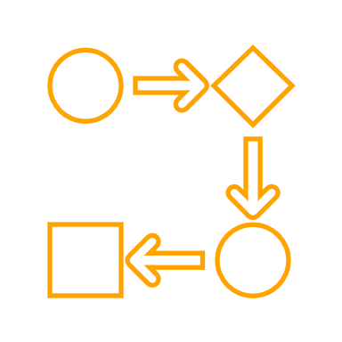










Problem Statement
Our debug/root cause and fix velocities are too slow
~6.5 days of effort to resolve each bug (spread over several weeks)
Our SSD devices are complex
Analysis (root-cause) requires a broad and deep understanding of FW/system
FW developers must spend time understanding context of bug or seeking expert council
Large number of issues to resolve strains expert availability
(Example) ADP program to date has seen just over 3,000 bugs
Hard to predict drive failures (asserts, perf, power, …)
We’re usually test-and-check
Notes:
In today’s performing state, it takes 6.5 days of effort to resolve bug and the timeframe to resolve it can linger for several weeks. The challenge is the resolution at its core is due to complexity of relational polices, mechanisms, exchanges, and events. As a consequence, the resolution requires a broad and deep understanding to address these faulting and anomalous states. The most optimized approach to solve these challenges are to develop task forces consisting of experts in various domains. To provide a background on the volume of the a given product program, we queried JIRA and were surprised to see over 3000 observed total bugs as of last week. The sheer volume explains the limited availability of experts and these were exposed through our continuous validation testing. The resolution of these were typically completed through the cycle of development, experiment, and re-testing with predicting outcomes ahead of time being on the order of complexity to solve the bug.
The impact of saving 0.1 person days of effort per bug (i.e. 0.8 person hours). Would yield 2,400 hours saved (0.8 person hours times 3,000 = 2400 person hours). When taking these into account a highly productive work week of 40 hours, we see on the order of 60 engineering weeks saved.

Slide 5






Environment Observation and Hypothesis
Observation
We are people, resource, and time constrained for BU expectations
Hypothesis
We can amplify our expert(s) capabilities and influence through automation
Agent(s)
Action(s)
State(s), Reason(s)
Situation(s)
Assessment(s)
Notes:
To summarize the findings of observation, we can see the active state shows a slow bug closure velocity, missed SLAs, and stretched project milestones/PRQs (David Roymoder). The takeaway is we are people, resource, and time constrained for the sustainable growth of the BU. The hypothesis is if we can amplify our expert’s capabilities and influence through automation then we can meet the expectations of the business unit entering the market sooner for our products.
An additional note is today, we do not have the ability to provide analytical confidence in product degradation without empirical execution. The human driven feedback has not been consistent; thus automation enables stabilization in resolution.

Slide 6
Challenge(s) in our Environment (Visualization)
Analysis, Experimentation, & Simulation
Data Control Management
Object ids
Git – Source Control
FW Source
FW Compiler
FW Binary
Test tools (Conval, PV, …)
Failures
JIRA
Telemetry binaries
Telemetry Extractor
Telemetry objects
Triage Tool
Likely root
causes
Dictionary of Telemetry Objects
Execution
Data
Crawler
Cross Language Compiler & Parser
Failures
Data Lake
Meta
Customer
Debug Handbook
Not used
Lots of data is available, including multiple fw versions and telemetry. But not used ☹.
Need to turn this data into intelligence and automated-analyses.
Notes:
With the environment today, we can see the directed acyclic graph above showing the interactions between our code, build system, execution, fault tracking system (JIRA), developer interactions, expert documentation, and our data lake (warehouse). The additions the telemetry effort has increased the automation capabilities in connecting the source code with our data through a centralized data management system. The addition of the cross language compiler means we can generate parsing scripts simultaneously with our firmware binaries to quickly interpret telemetry meta data in a standalone manner. The rapid interpretation is significant to exploit the live snapshotting capabilities of host initiated telemetry. The snapshotting provides developers with the key meta data on the device state such that we can load it into a simulator to probe system as if we were attached to a live device. With the debug handbook today, developers can take the state a use the documentation as a guide for resolving the issue. The beauty of the ecosystem we put in place with telemetry and customer engineering working group is as we encounter issues developers can share their knowledge, techniques, and critical thinking skills thereby enabling other developers to grow their own capabilities. The challenge of today’s state is we have a wealth of data without an easy way to navigate and analyze the relevant context. Our collaboration with our system integration team has enabled our triage tool to uses quite a bit of the data; however, the context is still limited due to the expert context not being automated.

Slide 7
Solution Vision
Reduced human analysis, Experimentation, & Simulation
Data Control Management
Object ids
Git – Source Control
FW Source
FW Compiler
FW Binary
Test tools (Conval, PV, …)
Failures
JIRA
Telemetry binaries
Telemetry Extractor
Telemetry objects
Triage Tool
Dictionary of Telemetry Objects
Execution
Data
Crawler
Cross Language Compiler & Parser
Failures
Likely root causes
Data Lake
Meta
Customer
Debug recipe
Debug Handbook
Execution, Defect Data
FW Sources
Likely root causes
Dev Analysis Modules
MP Engine(s)
Handbook Code
Codify the techniques listed in the debug handbook
Automated Analysis Reports to reduce human effort
(includes Expert Issue Context, Anomaly Prediction)
Machine Programming engines use fw-sources, defect info, debug-handbook,
and extensive telemetry to generate automated analyses
Notes:
The solution vision to resolve the ocean of data is use the handbook information to codify the techniques into expert analysis library modules, then use techniques in machine programming to reduce the scope. Once we have the scope reduced, we can then systematically use machine learning to determine relation of telemetry data, source code, JIRA, triage, and handbook analysis modules to train artificial intelligent agents to enhance the reports for developers. The interesting focal point to the vision is; while we continuously develop can we teach these agents to observe, identify, and predict the outcome of development in real time.

Slide 8
Pathfinding Questions
Using telemetry, fw-sources, and MP engine(s) to evaluate a SSD bug, is it possible to deliver automatically generated expert domain analysis to expertly evaluate it?
Focus on two of the top NVMe SSD FW Customer Asserts:
DF049: Wear leveling issue
MB002: Mail box command queue issue
What is the minimal telemetry data required, and what sw is required to generate this analysis?
Using telemetry, fw-sources, and MP engine(s) to evaluate a SSD drive, is it possible to detect and predict future behaviors (profile normal, error path handling, and anomalous states)?
Focus on two NVMe SSD FW modules
Wear leveling
Mail box command queue
What is the minimal telemetry data required, and what sw is required to generate the predictions?
Notes:
To focus the pathfinding, we have distilled two significant questions to determine the feasibility.
Using telemetry, source code, and our machine programming engine(s); is it possible to automatically generate expert given analysis to evaluate and resolve a bug?
Building the vision ecosystem can we detect the key features of the environment to generate a model of the current device behavior to predict a crucial state of the device?
The focused challenges to address are wear leveling and transport command processing. From these focused topics, what is the minimal data and software to generate automated analysis, detection, and prediction.

Slide 9
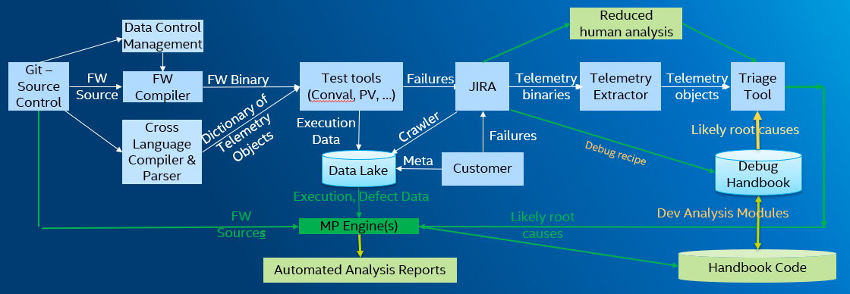
Pathfinding Question 1 of 2
Q1: Using telemetry, fw-sources, and MP engine(s) to evaluate a SSD bug, is it possible to deliver automatically generated expert domain analysis to expertly evaluate it? What is the minimal data required, and what sw is required to generate this analysis?
Focus on two of the top NVMe SSD FW Customer Asserts:
DF049: Wear leveling issue
MB002: Mail box command queue issue
Plan to answer question
Observe expert analysis for the asserts, then automate it through MP
Create expert context analysis module(s) and library
Develop the handbook code for DF049 and MB002
Develop the MP-based framework
Create informed report containing likely root causes
Includes analysis of adjacent module
Extend Triage Tool to utilize the MP engine
(Stretch) Extend the solution to scale beyond the 2 asserts
Develop framework to add capability to recommend expert module
Notes:
To answer the question(s), we plan on observing the context on a given challenge through JIRA and taskforces to understand the dependent and independent variables in machine programming automation. Given these contexts, we review the handbook, improve, and codify the root-cause analysis techniques into a set of module and system analysis libraries. These libraries will use the expert analysis of anomaly’s symptoms to create audits of state, requirements, and expectations. To start we have picked one issue from our lead program then from the lens of a expert mentoring an new engineer distill the essence and intent of analysis. These analysis module engines are the key policies in reducing the scope of the bug thus easing resolution. Given our device is build of intertwined modules, we will then construct a set of expert modules thus constructing a system state module engine(s). The desire of these collection of system modules is to rollup overall scope (global view) similar to our taskforce findings to account for interactions between sets of modules.

Slide 10
Pathfinding Question 2 of 2
Q2: Using telemetry, fw-sources, and MP engine(s) to evaluate a SSD drive, is it possible to detect and future behaviors (profile normal, error path handling, and anomalous states)?
Focus on two NVMe SSD FW modules
Wear leveling
Mail box command queue
What is the minimal telemetry data required, and what sw is required to generate the predictions?
Plan to answer question
Extend framework developed to answer question 1, to include predictions.
Generate prediction report from MP-engine
Details
Example: thermal issue prediction
Notes:
Building on our expert blocks and interpretation of state, we will focus to extract the key features for a particular outcome to determine if we can take random samples relevant data to search and identify an anomaly. By being able to search and identify, we can create AI agents to speculate the next probable events. In developing the solution we plan on having our partners investigate a given area based on expertise. To provide direction on state of the art techniques, we are collaborating with Intel Labs on the machine programming MP direction. The direction will be assisted by MIT (under IL direction), UCR (under NSG collaboration on big data processing), and more as we go along.
To show high-level feasibility, we device choose to analyze thermals of an SSD since our dual port products can over heat in idle. Furthermore, thermals analysis is core technique taught in computer engineering; thus, we believe it would be the most impactful way to verify the algorithms.

Slide 11
STG RAAD is collaborative effort with Intel Labs & IAGS
STG
(RAAD-PF)
Automate
Automate Expert Contextual Analysis (leverage IL’s MP)
Predict anomalous drive behavior (NSG & IL algorithms)
Notes:
To iterate over the last slide, we are collaborating and collecting techniques to generate expert context from internal experts with existing Intel Labs algorithms. The early findings on predictive behavior is from fusing the ideas and algorithms into a sample machine programming engine.

Slide 12

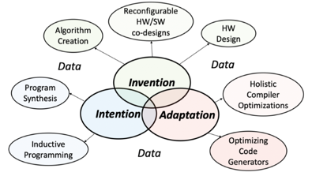
STG RAAD is in collaboration with Intel Labs & IAGS
Intel Labs 2019 TSLRP (MP) –IL/IAGS/NSG
STG
(RAAD-PF)
IL Machine Programming (MP) – per 2/26 PF info update
New ﬁeld of research concerned with the automation of SW & HW
NSG to leverage/amend existing capabilities/algorithms
Directly apply IL’s latest research in time-series anomaly and performance regression debugging
IL to leverage NSG’s Prediction algorithms and vice-versa
Note: NSG to pioneer the empirical usage of Telemetry data via Data Lake
Notes:
Those that were able to attend the earlier presentation will notice we have leveraged CAPA to incubate, merge ideas, BKMs, and the capabilities of Intel. The icon below is to remind of context. We plan on using all of the findings in universities and intel to drive answering the pathfinding questions. The fuel for all of the work is data; thus, data lake is a partner to produce results from telemetry data.
https://nsg-wiki.intel.com/pages/viewpage.action?pageId=168682508
https://nsg-wiki.intel.com/display/FW/NSG+One+API

Slide 13
Pathfinding Plan - Headcount
STG Headcount
STG Pathfinding Team
Lead PI Architect – Joe Tarango 80%
Project Lead/Co-PI – Jim Baca 50%
Undergrad Interns – Andrea Chamorro (ends internship April 30th), Tyler Woods, Daniel Garce (begins in May)
Grad Intern – PanteA Zardoshti (starts soon)
Other Org Headcount
Alberto Sanchez – 10%
Andy Sainz (DND) - 10%
Justin Gottschlich (Joint IL/IAGS/NSG Machine Programming (MP) Research)
Total of 1.5 people applied initially
Will apply more resource as necessary
Charles Anyimi (NSG NSM) – As needed
Kathryn Carruthers (NSG Data Lake) 5%
Nitin Jain (IT) 5%
Paul Petersen (IAGS) - As needed
Tim Rothman (NSG DND Thermal) – As needed

Slide 14
Pathfinding Plan – Deliverables/Timeline
Phase 1: Develop scalable analytics framework for telemetry Q2-Q3
Data Lake telemetry capture and extraction
Solidify APIs to enable templating across BUs
Phase 2a: Automate expert analysis through MP for the focus-asserts Q3-Q4
Produce Automated Analysis Report - Expert Issue Context AMB: at least 80% matches what a human would generate
Develop method to integrate MP-output report with JIRA and Triage tools
Define APIs for tools to use for productization
(Stretch) Apply algorithms to other defect types
Phase 2b (in parallel): Develop behavior-prediction for wear-leveling and mail boxes. Q3-Q1
Automatically detect failure behaviors
Using detection automation preemptively predict behaviors
PF-Exit Q2’21
Present findings to staff and technical forums
Discuss and develop plan with stakeholders on technology transfer to similar applications
Document, review production readiness, and provide mentoring-trainings in technology

Slide 15
Partner Enabling Plan
Productization Plan Collaborators:
IL (MP)
IAGS (Intel Code Advisor)
DND (Triage)
Data Lake (Collaborate to develop Intel® Autonomous Machine Programming Ecosystem)
Partners:
Justin Gottschlich (IL), Paul Petersen (IAGS), Robbie Frickey (DND), Albert Sanchez (DND Triage Tool), Tim Rothman (DND Thermal), Kathryn Carruthers (Data Lake)
Anticipated enabling elements necessary post PF-exit:
Integration of module libraries in the solution vision flow.
Incl. addition of new modules into respective libraries
Partner has reviewed PF questions?
Yes

Slide 16
PF Entry Approval Request
Pathfinding Questions
Using telemetry, fw-sources, and MP engine(s) to evaluate a SSD bug, is it possible to deliver automatically generated expert domain analysis to expertly evaluate it?
Focus on two of the top NVMe SSD FW Customer Asserts:
DF049: Wear leveling issue
MB002: Mail box command queue issue
What is the minimal telemetry data required, and what sw is required to generate this analysis?
Using telemetry, fw-sources, and MP engine(s) to evaluate a SSD drive, is it possible to detect and predict future behaviors (profile normal, error path handling, and anomalous states)?
Focus on two NVMe SSD FW modules
Wear leveling
Mail box command queue
What is the minimal telemetry data required, and what sw is required to generate the predictions?
Timeline: Approval + 5 quarters (Q2’20 – Q2’21)
STG Resources:
Joe, Jim, 1 graduate intern, 3 undergrad interns
Approved?
Notes:
As we answer the questions, more will arise, so we want to stay flexible to address these in the future. With all of this in mind, we now would like to ask if the path finding entry is approved?

Slide 17
DellEMC
“DellEMC will need to work closely with Intel to advance capabilities that will allow out of band telemetry features to support a spectrum of usage scenarios that have differentiating value. The usage scenarios include: known good state determination, advanced diagnostics, predictive failure identification, workload performance measurement and optimization, failure mode cause analysis, and autonomic management to list a few. Additionally, Intel support for a framework and capability that enables DellEMC embedded instrumentation and management to select and optimize telemetry acquisition and optimization for Intel provided components will enable a win-win situation where DellEMC compute platform offerings can target and tune the platform telemetry for specific environments and solutions.”
Elie Jreij VP, Fellow (DELL)

Slide 18
Questions?
Special thanks to all of the collaborators, mentors, and co-travelers.

Slide 19
Appendix Material
The content below is included to provide additional context and answers to potential questions. The notes on the slides are to provide context for offline reading. Please feel free to setup 1:1s to get deeper detail into any particular items.
We embrace the inclusion of additional ideas or approaches, so please feel free to discuss additions in follow up meetings.

Slide 20
Appendix Material

Slide 21
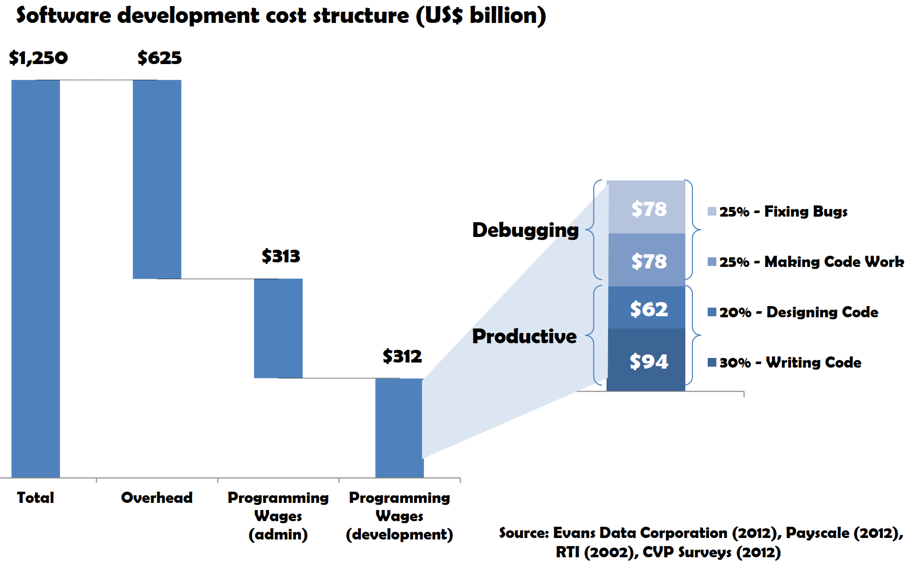
Background : Quantification of the Global costs associated with Development
University of Cambridge Case Study
US$156 Billion per year Wages-only estimated cost of debugging
US$312 Billion per year TOTAL estimated cost of debugging including wages and overheads
Programmers Time
50.1% General Tasks & Development
49.9% Debugging
Projected Outcome(s)
Effective debugging technique(s) can save 26% in debug time
Net Global Savings Potential $81 Billion
Bottomline
We have opportunities
Reference: Britton, T., Jeng, L., Carver, G., Cheak, P. & Katzenellenbogen, T. (2013) Reversible Debugging Software: Quantify the time and cost saved using reversible debuggers
Source: Evans Data Corporation (2012), Payscale (2012), RTI (2002), CVP Surveys (2012)
Notes:
To start off the discussion, I wanted to show a study from Cambridge related to cost for developing software. In the context of our firmware systems today; we are closer trending to complexity in software design. The focal point of the slides is to highlight the necessary overhead associated with debugging costing nearly 1.56 Billion across the world. If we apply to projection to the expenses in NSG, we have significant opportunity to refocus developer time onto future technologies amplifying the growth potential.
*According to 54 questionnaire responses to the CVP survey and 11 interviews, based on the question ‘what percentage of your time is spent programming (e.g. designing, writing, testing, debugging etc.) compared with other tasks (e.g. admin, meetings, sales, etc)?’ Other tasks were then grouped as ‘admin’. **According to 54 questionnaire responses to the CVP survey and 11 interviews, based on the question ‘Of the time spent programming, what percentage of your time is spent on the following: (1)fixing bugs (2)making code work (3)designing code (4) writing code.’ (1) and (2) then were grouped as debugging.

Slide 22
Environment
Telemetry is available & is the fuel that drives ability for Intel to root-cause drive failures efficiently
We have… one toolkit to access Telemetry content in all forms
Developer Simulation (GHS, ARM CPU simulation)
Outputs: scripts and objects
Data Control Management API to access and mutate the context around an object
ID, security classification, description, etc.
Output: Text and CVS format
Build process, automation, and Cross-Language Translate Compiler of Code
{C, C++} to {Intermediate Representation, Python, XML}
Notes:
In todays environment telemetry has shown to be a catalyst for time to data. The ecosystem we have constructed consists of a simulator, management API, and cross language translator to automate the repetitive tasks in a centralized and simple manner.

Slide 23
Environment (Continued)
We have… one toolkit to access Telemetry content in all forms.
Developer Intel Toolkit
Object extract, map, decoding, binary, and text output system
Triage is a high level symptom ranking system to enable AEs to quickly provide customers with likely root cause of issues
Outputs are: report, decoded objects, and binaries
Notes:
Building on the ecosystem, we have created a streamlined tool kit that prepares raw telemetry data for the various audience members. Furthermore, we have collaborated with the system integration team on the triage tools to use the features on high level data analysis.

Slide 24
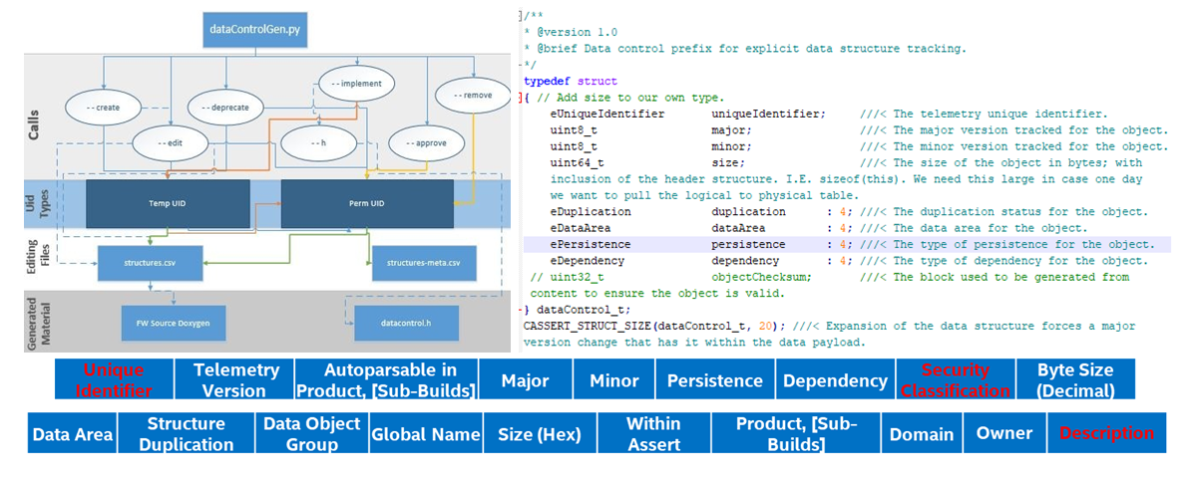
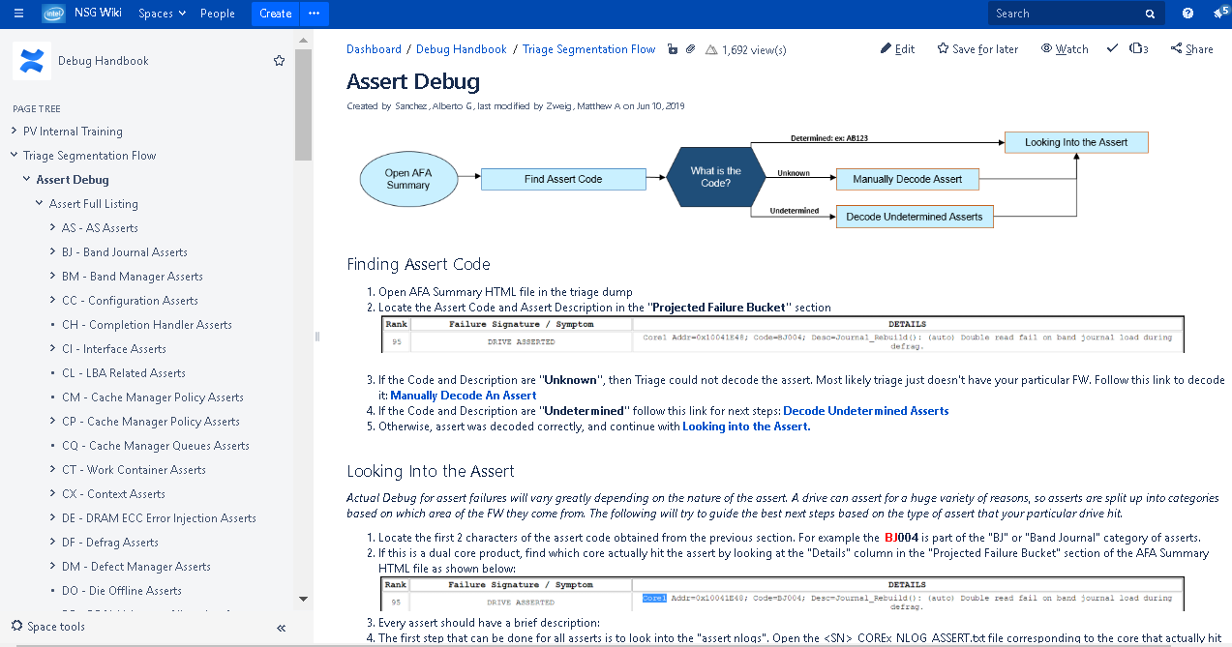
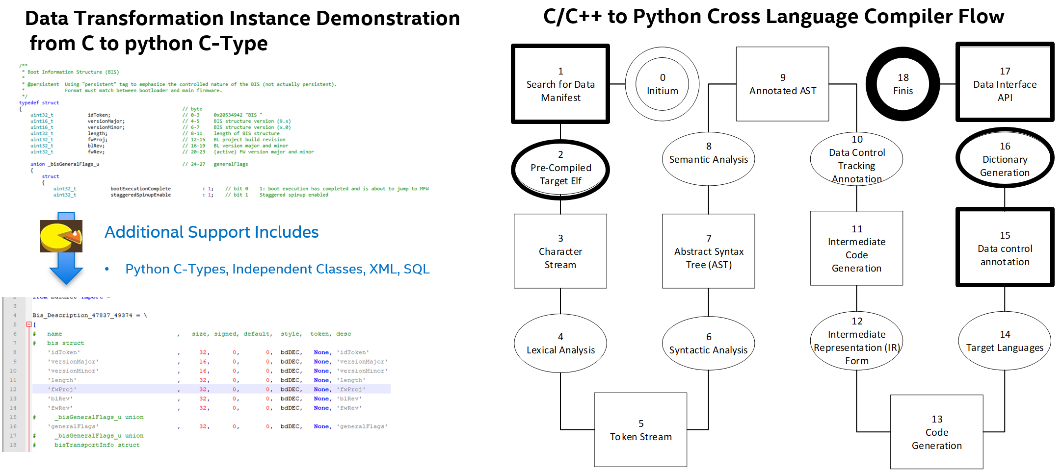
The automation efficacy, we have completed
Automated data control across repositories
Created baseline of NSG Analysis Handbook
Generation of telemetry auto parsing
Notes:
The following is a visualization of the systems generated the upper right is the data control management system, lower right is the debug analysis handbook, and the lower left hand side is the cross language compiler. The details for each of these can be found in the generated wiki page content.

Slide 25
Environment Observation
Customers expect a rapid response
Our root cause/fix velocities are still too slow
Our SSD devices are complex (Transport, Core Algorithms, HAL, etc.)
Analysis (root-cause) requires a broad and deep understanding (Complexity requires time-to-grow or technical experts (~1 year))
Technical Experts are rare (takes years to develop, many FW developers lost to attrition)
Our best are overloaded (limited access to them, developers lucky to get any time with the experts)
Notes:
Our velocity is too slow to ensure BU scalability.
Our SSD devices are complex
Firmware Transport, Core Algorithm(s), Hardware Access Layer(s), etc.
Co-operative and interrupt operating system(s)
Media Policies
Analysis (root-cause) requires a broad and deep understanding
Complexity requires time-to-grow or technical experts
Technical Expert(s)
Rare to find internally and externally
Developing new experts takes mentoring time…
Our best are overloaded (limited access to them)

Slide 26
Opportunities
Customer Demand
Too many NSG datacenter SSD PRQ milestones missed
NSG customer SLA is being violated due to complexity in our domains (NAND and Optane™)
Bottomline: We collect the Meta data to simplify the process and know how to use the data
Domain knowledge is restricted to a finite set of individuals; thus, make it accessible through automation
Training has not shown acceleration or velocity at a magnitude our organization needs
Anomaly Analysis
Internally, triage shows promise to accelerate comprehension and development
If embraced, the methods in Triage show promise for uptime software services (customer/parallel BUs) for field devices.
Anomaly Detection and Predictive Analysis
We do not have the ability to provide analytical confidence in product degradation without empirical execution
Future Design Improvement (stretch goal)
Human driven feedback has not been consistent; thus automation enables stabilization in frequency
Performance acceleration through automation of state detection (Patent Pending)
Notes:
Empower engineers with the an ecosystem to provide recommendations in assessment pf anomalies through expert driven analysis modules; reducing reactive time; thus, proactively decreasing development time for SSDs. These fundamental modules open the realm of host driven system prediction, performance acceleration, and enhancement of future products.

Slide 27
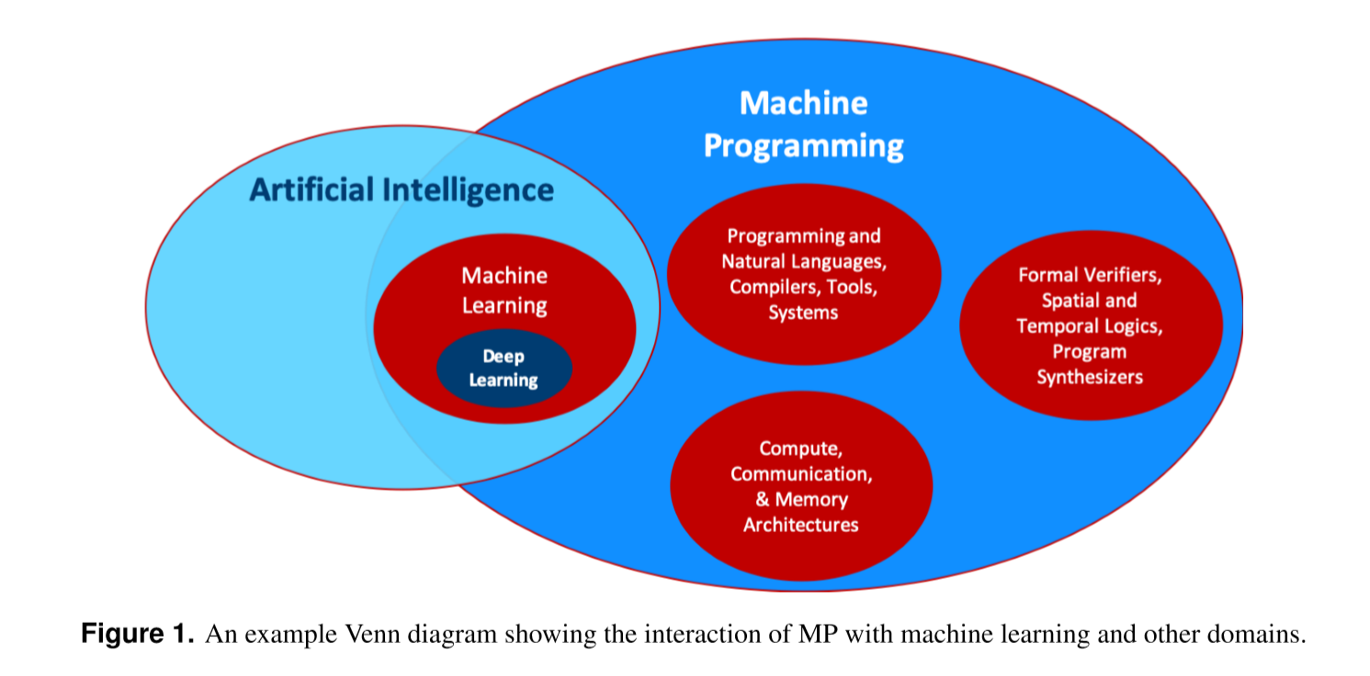
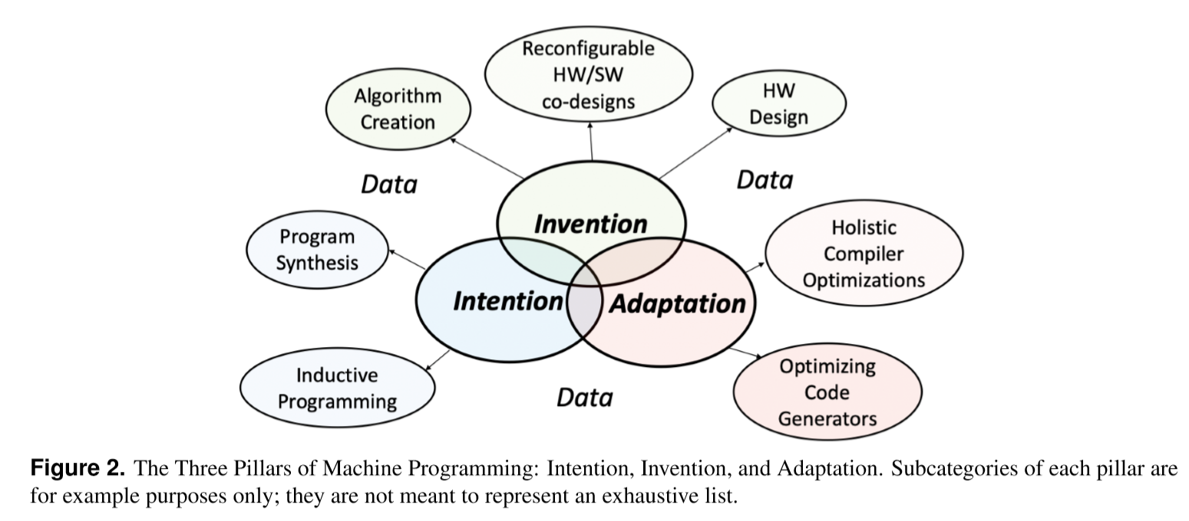
One Intel - A Quick Overview of MP
The general goal of MP is to remove the burden of writing correct, efﬁcient, and secure code from a human programmer and to instead place it on a machine.
MP’s high-level compelling endpoint is concentrated on
Improving programmer productivity by at least 2x (requiring < 1% of today’s effort)
Superhuman code creation aimed at performance, correctness, security, and accuracy
Self evolving system adaptation.
Reference: SSR Proposal Machine Programming (003).pdf – Justin Gottschlich
Notes:
Intention corresponds to the class of challenges involved in capturing a user’s intent, ranging from techniques to construct new software [23,25] to systems that can lift semantic meaning from existing software [26,27]. Correctly capturing a user’s intention is critical for automation of software for at least one fundamental reason. Many of today’s programming languages, like C++, Java, and Python, tend to blur the lines between a user’s intention and the implementation of that intention.
Invention emphasizes the creation or reﬁnement of algorithms or core hardware and software building blocks. For program construction and maintenance, invention usually involves generating the series of steps that a machine would have to execute to fulﬁl lauser’s intent. In essence invention is the process of generating algorithms. This includes discovering new algorithms that are unique and different from prior contributions in the same space.
Adaptation - Determining the algorithmic steps to solve a problem, the principal focus of the invention pillar, is only one part of the software development process. The resulting algorithms must also be made to run correctly, efﬁciently, and securely, on one or more target platforms. Moreover, after the code is deployed in the ﬁeld, the code must be maintained as users expose bugs or corner cases where the system does not behave as expected. In addition, as workloads on the system evolve, it may be necessary to re-evaluate optimization decisions to keep the software running at its peak performance. Together, these capabilities make up the adaptation pillar.

Slide 28
Solution Vision (Simplified)
Reduced human analysis
Data Control Management
Git – Source Control
FW Source
FW Compiler
FW Binary
Test tools (Conval, PV, …)
Failures
JIRA
Telemetry binaries
Telemetry Extractor
Telemetry objects
Triage Tool
Dictionary of Telemetry Objects
Execution
Data
Crawler
Cross Language Compiler & Parser
Failures
Likely root causes
Data Lake
Meta
Customer
Debug recipe
Debug Handbook
Execution, Defect Data
FW Sources
Likely root causes
Dev Analysis Modules
MP Engine(s)
Automated Analysis Reports
Handbook Code
Notes:
The solution vision to resolve the ocean of data is use the handbook information to codify the techniques into expert analysis library modules, then use techniques in machine programming to reduce the scope. Once we have the scope reduced, we can then systematically use machine learning to determine relation of telemetry data, source code, JIRA, triage, and handbook analysis modules to train artificial intelligent agents to enhance the reports for developers. The interesting focal point to the vision is; while we continuously develop can we teach these agents to observe, identify, and predict the outcome of development in real time.

Slide 29
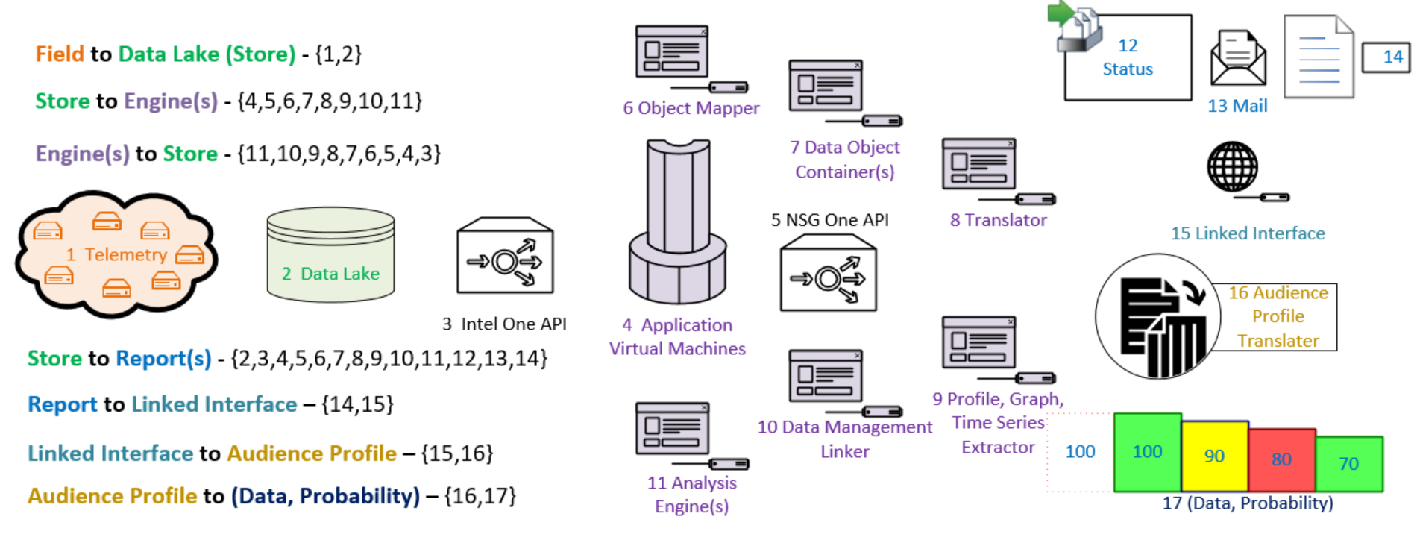
Solution Vision Framework
Share Framework with IT - Optimize for Enterprise
Notes:
The vision of the framework used the telemetry data piped through data lake to store all of the content. The content would then be accessed and put into the NSG API containers for virtual machine processing. The processing is expected to be completed in simple application modules in sequences to enable analysis, status updates, and audience profile targeting.
Collect all Telemetry binaries
Associated system meta data into Data Lake (DL)
Create NSG One container API
Extract, parse, map content, etc.
Streamline data into Intel’s One API to create applications
Access, search, cluster, etc. the data from DL to provide context
Create MP algorithms, capabilities, etc. (existing/create new)
Share Framework with IT
Optimize for Enterprise

Slide 30
Forecasting and Scaling the Vision Framework
Extend Intel One API for drive telemetry content in order to automate RAAD via MP
Telemetry and associated system meta data into Data Lake (DL)/AXON
Create NSG One container API
Extract, parse, map content, etc.
Streamline data into Intel’s One API to create applications
Access, search, cluster, etc. the data from DL to provide context
Create MP algorithms, capabilities, etc. (existing/create new)
Share Framework with IT - Optimize for Enterprise
Note: OneAPI programming model provides a comprehensive and unified portfolio of developer tools that can be used across data management
Engine, hardware target, range of performance libraries
Notes:
Speaker notes: keep the slide short. Takeaway is framework!
The system feeds into our Intel One AIP for compute on any our internal compute.
Note: Add one liner for Intel one API. Opens up all of our intel ecosystem tools (AI and accelerators to use in an easy way.
Collect all Telemetry binaries
Associated system meta data into Data Lake (DL)
Create NSG One container API
Extract, parse, map content, etc.
Streamline data into Intel’s One API to create applications
Access, search, cluster, etc. the data from DL to provide context
Create MP algorithms, capabilities, etc. (existing/create new)
Share Framework with IT
Optimize for Enterprise

Slide 31






Pathfinding Questions
Using telemetry, fw-sources, and MP engine(s) to evaluate a SSD bug, is it possible to deliver automatically generated expert domain analysis to expertly evaluate it?
Focus on two of the top NVMe SSD FW Customer Asserts:
DF049: Wear leveling issue
MB002: Mail box command queue issue
What is the minimal telemetry data required, and what sw is required to generate this analysis?
Using telemetry, fw-sources, and MP engine(s) to evaluate a SSD drive, is it possible to detect and predict future behaviors (profile normal, error path handling, and anomalous states)?
Focus on two NVMe SSD FW modules
Wear leveling
Mail box command queue
What is the minimal telemetry data required, and what sw is required to generate the predictions?
Environment
Agent(s)
Action
State, Reward
Notes:
To reiterate, when answering the pathfinding questions we will be reflecting on the mechanisms in machine programming to create AI agents to drive actions on the environment, fueled by human interaction/recommendations to enable a continuous learning ecosystem to build the foundation for our future in machine programming.

Slide 32
Proposed Focal Point(s) for Analysis
We propose providing new capabilities
Automate expert contextual analysis to expedite debug root cause (based on Telemetry data)
Observe expert analysis, then automate it through ML
Provide a framework library for module analysis to execute as application engines
Link module analysis reports to system application engines
Extract signatures of Data to detect and predict anomalous drive behavior
Detect anomaly behavior
Model behavior (Stretch)
Forecast and predict fractals (Stretch)
Create intervention behaviors or service events (Stretch)
Notes:
Results in a slow bug closure velocity, missed SLAs/project milestones/PRQs (David Roymoder has more examples). We do not have the ability to provide analytical confidence in product degradation without empirical execution. The consequence is human driven feedback has not been consistent; thus automation enables stabilization in frequency. The key is to use the scientific method to automate the expert context to enable the organization through a framework. The framework focuses on scalability so we an extract state signatures, detect the current state, then use those characterizations to model the behavior for prediction.

Slide 33
Technical Approach Plan
Enable IT Framework: Extend Intel One API for telemetry content in order to automate RAAD via MP
Pick major fault (lead trunk product) and observe how it was solved by human experts
Identify, gather, and use Telemetry required to provide auto expert context on the fault
Automated expert analysis
Train MP system(s) on that telemetry data
Create benchmarks, verification, ROC (receiver operating characteristic), etc.
Repeat on a set of additional classes of issues and propose a general infrastructure
Notes:
The technical plan is the once again focus on scalability through an API. The first set of focus points are addressing major challenges by using data to drive the highest impact. With all of the data we need to identify, gather, and effectively use the telemetry data to drive expert context. The expert context is critical to root cause faults; thus, if we can automate it we amplify the organization’s reach across the ocean of data. The MP system will require focused benchmarks, verification, and ROC for consistent data feedback from the applications. The process outline is constructed in a manner to be scalable for other challenges build on the adjacent context.

Slide 34
Generalized Approach
Solution approach:
Apply successful techniques from scientific method.
Domain | Challenge | Solution
HAL | Thermals in Dual Port | Learned Approximate Profile (3 Slides Ahead)
Transport | Mailbox tracking of TAPs | Markov Decision Process (MDP) (Two Slides Ahead)
Core | Performance free space crash | Auto-Perf (Next Slide)
HAL | PMIC (Power management) | To be explored (TBE)
Media | NAND-Optane Stability | TBE
… | … | …
Tools | Compatibility of Data | TBE
Common | Code stability in Testing | TBE
Common | Debug Assert | TBE
Common | Debug Bad Context | TBE
Common | Performance Bottleneck | TBE
Learning Methods | Summary
Regression | Predict or explain a particular numerical value based on a set of prior data
Classification | Predict or explain a class value
Clustering | Group observations that have similar characteristics
Dimensionality Reduction | Remove the least important information
Ensemble Methods | Several predictive models to get higher quality predictions.
Neural Networks (NN) Deep Learning (DL) | Capture non-linear patterns in data by adding layers of parameters.
Transfer Learning | Re-using part of a previously trained neural net and adapting it to a new but similar task.
Reinforcement Learning | An agent learn from experience.
Natural Language Processing | Technique to prepare text for learning.
Word Embeddings | Numerical representations of text documents that only consider frequency and weighted frequencies.
Notes:
Definitions:
Root-cause analysis techniques (Module and system analysis)
Expert analysis of anomaly’s symptoms (Use modules to create audits of state)
The table on the left hand size shows the major domains, challenges, and potential solutions. At the moment, we have scoped potential candidates on the approach based on the machine learning methods listed on the right hand side.

Slide 35
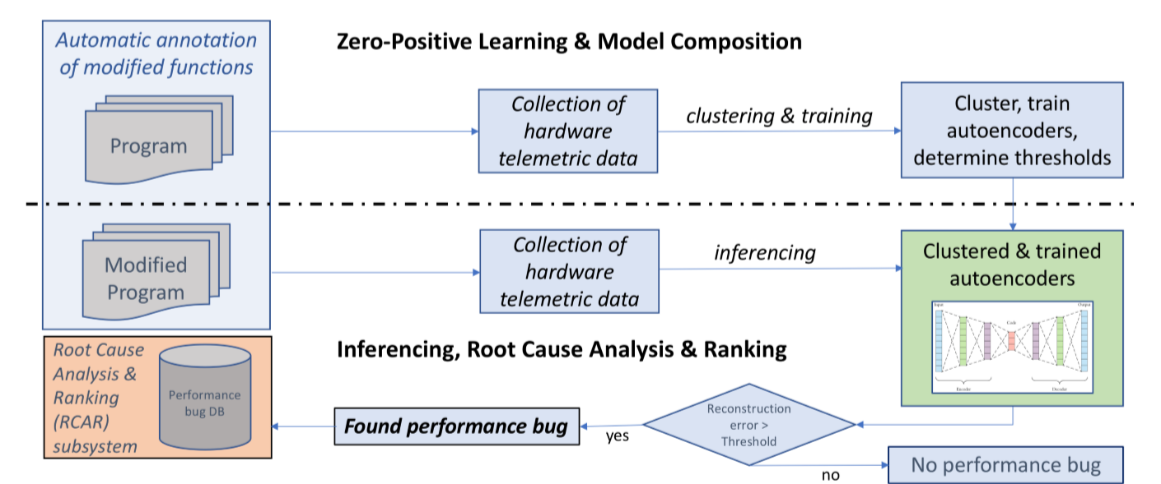
Anomaly Detection Approach
Solution approach:
Leverage Intel Lab’s AutoPerf to generate context
NSG Work: Create a template
Output: Generate report
Intel AutoPerf Block Diagram with Telemetry Usage
AutoPerf reference: SSR Proposal Machine Programming (003).pdf – Justin Gottschlich
Notes:
The anomaly detection system from Intel labs has shown significant results internally and externally so we want to leverage the technology to template the usage in report generation provided the given context.

Slide 36


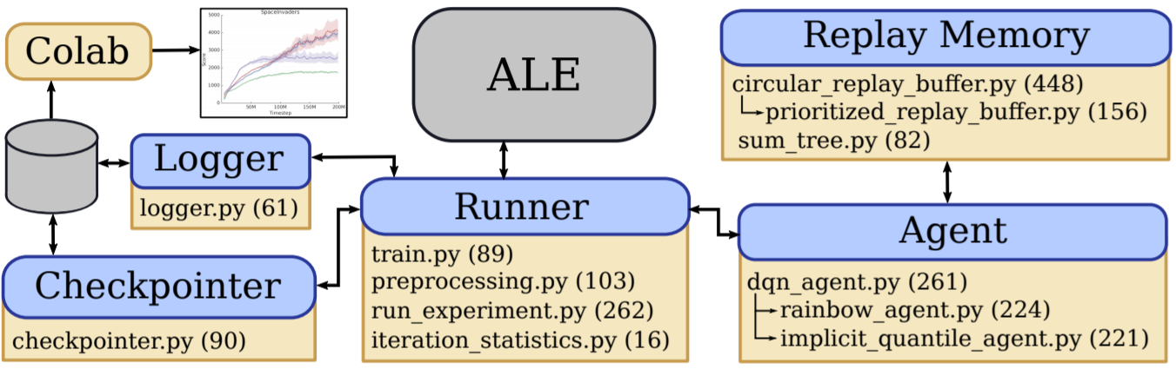





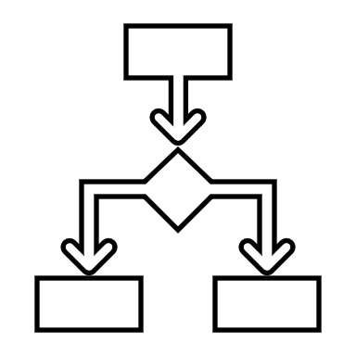

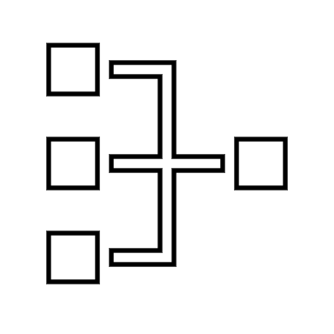


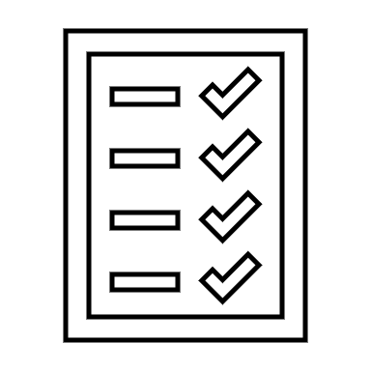


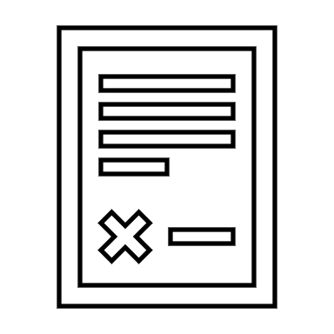
Application Plan for MP-Engine
Machine Programming Application
Telemetry Binary
Header | State
Table of Contents | Data List
Object(s) | Data State
Analysis Handbook
Entrance State | Assert, Bad Context, etc.
Significant Data Objects | Erase Table Band State
Methods to Evaluate Data | Erase Table to State List
Behavior Expectation | Interval, state, etc. ranges
I.E. Markov Decision
Process (MDP)
Decode Telemetry
Identify Entrance Reference Graph
State(s) & Transition(s)
Action(s)
Bellman Expectation
Select Policy
Machine Programming
Report
I O %
S,T A %
S SP V
Castro, Pablo & Moitra, Subhodeep & Gelada, Carles & Kumar, Saurabh & Bellemare, Marc. (2018). Dopamine: A Research Framework for Deep Reinforcement Learning.
Intel® Nervana™ reference deep learning framework. https://github.com/NervanaSystems, https://www.intel.ai/reinforcement-learning-coach-intel/, https://software.intel.com/en-us/ai/courses/distributed-AI-ray
Notes:
The approach for the expert context is build on the machine programming semantics; specifically the Markov Decision Process. MDP consists of a starting state, set of states within firmware, set of actions on the state, possible transition, discount factor (expected cumulative future reward for final evaluation),
Bellman equations to characterize the vector table of states to all other states to use a: Monte Carlo, dynamic programming, Deep Q learning, etc., and finally construction of a policy to select for the MP engine to use in the report generation. The discount factor will take all actions based on short term and long term rewards to for mutate a probabilistic from trained features. The interesting features are these reflect the human analytical approach and is integrated with an agent based AI model to train expert based deep neural nets.

Slide 37
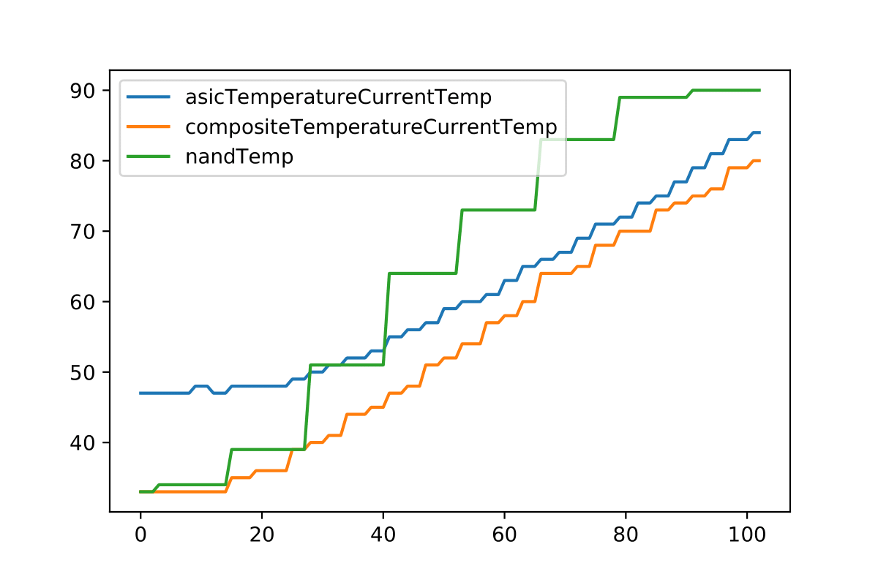
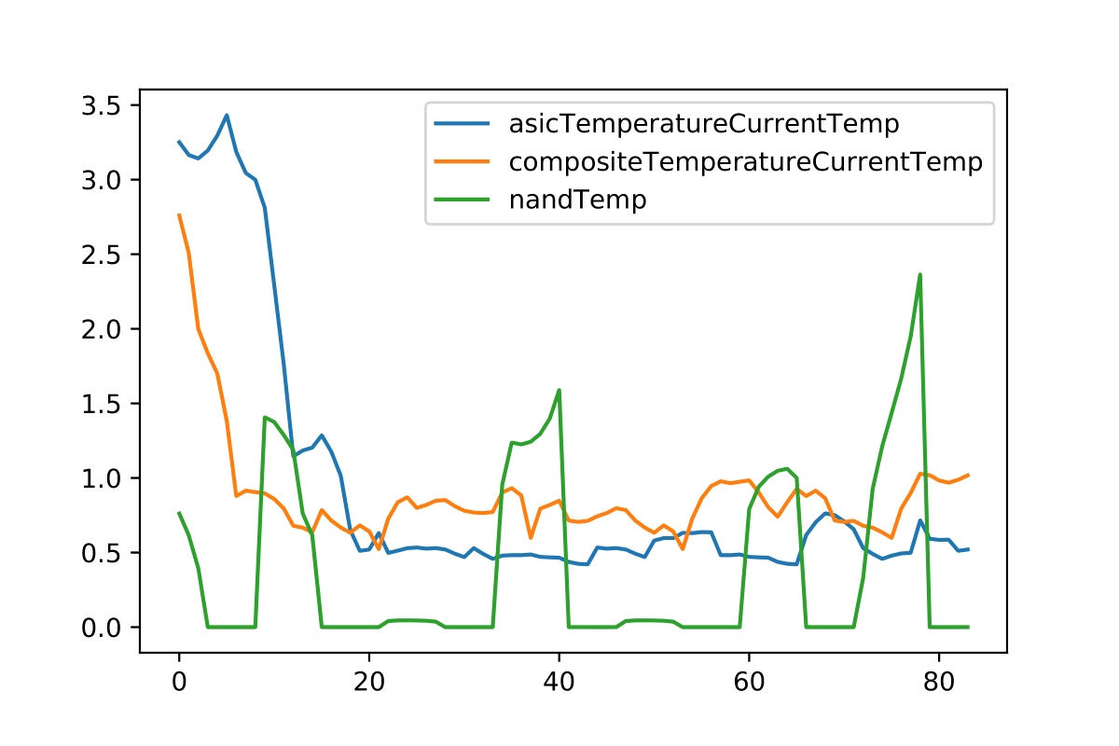
Example results for Thermal Profile State Detection
Experiment to exercise the algorithms
Thermal profiling of DP drives (overheat on their own with no fan)
Host Telemetry data pulled periodically and at failure
Collected meta time series data on: NAND temp, ASIC temp, Composite temp
Extracted Matrix Profiles (minimal state detection features)
Collect Meta Time Series
Extract Matrix Profile(s)
Compute Similarity, Train AI Modules, Predict
(See next slide)
Temperature (Celsius)
Unitless Domain Transformation
Notes:
The approach for thermal data evaluation was conducted on CDR DP. The product was chosen since it is possible to overheat at idle without adequate active cooling. The data sets to construct the base line were conducted through various known states of Normal operation (Idle, Workload) and failure (Idle, Workload). With these major targeted state, we extracted the thermal data from telemetry based on a cadence to construct state profiles from the time series data. The profile extraction uses a transformation function to switch the data to a unitless domain (signal) for each of the known profiles. These profiles are used to cluster the known states, features, and traits for the known end events.
In collaboration with Dr. Eamonn Keogh (top ten most prolific author in SIGKDD, ICDM, SDM, and Data Mining and Knowledge Discovery).
Algorithms: Euclidian Distance (ED), Pearson's Correlations (PS), Dynamic Time Warping (DTW), LB-Keogh, UCR Suite, eDTW, Mueen's Algorithm For Similarly Search (MASS), Learned Approximate Matrix Profile, STOMP, STAMP, SCAMP, Dynamic Point Library, etc
Matrix Proﬁle XVIII: Time Series Mining in the Face of Fast Moving Streams using a Learned Approximate Matrix Profile. Zachary Zimmerman, Nader Shakibay Senobari, Gareth Funning, Evangelos Papalexakis, Samet Oymak, Philip Brisk, and Eamonn Keogh (2019). IEEE ICDM 2019.
Euclidian Distance (ED) – Direct distance
Pearson's Correlations (PS) – 0 to 1 correlation
Dynamic Time Warping (DTW) – Relative distance

Slide 38
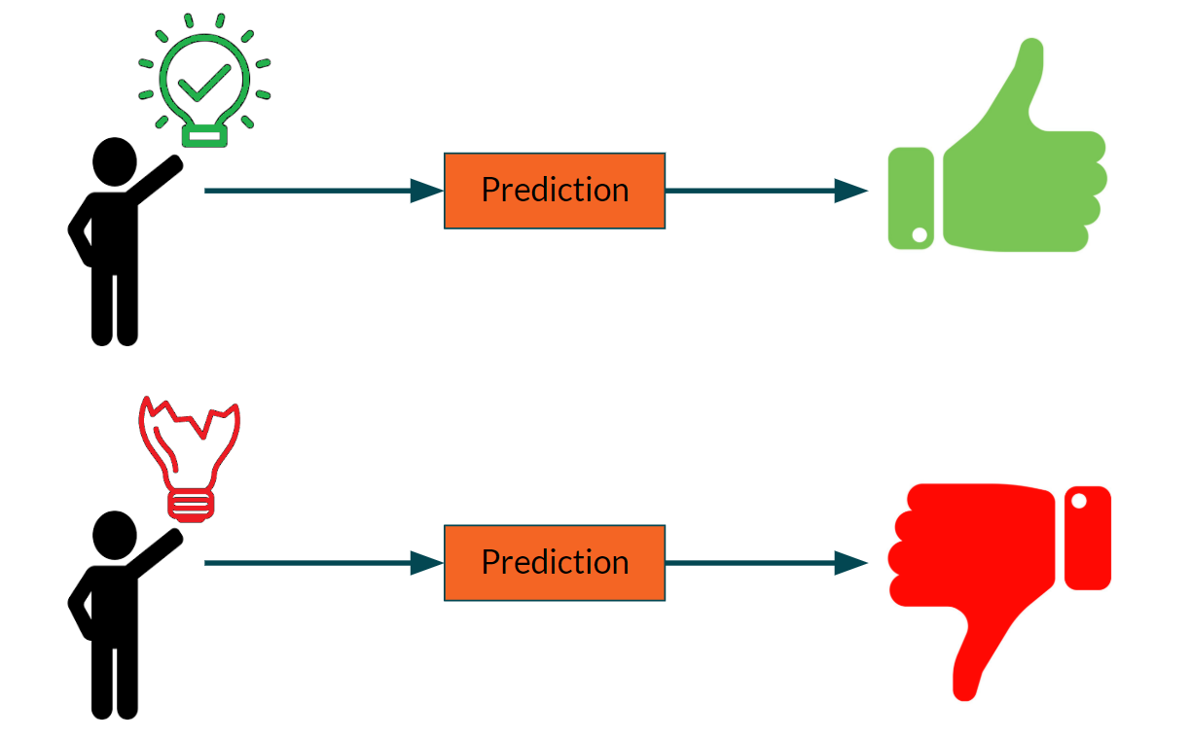
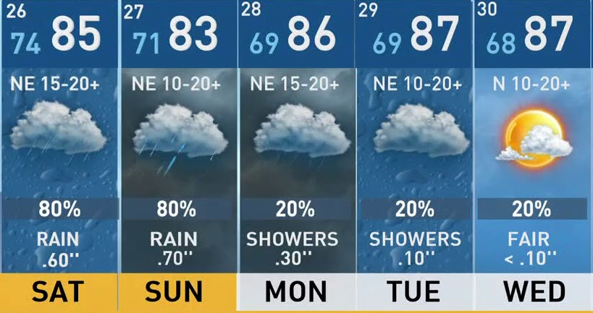
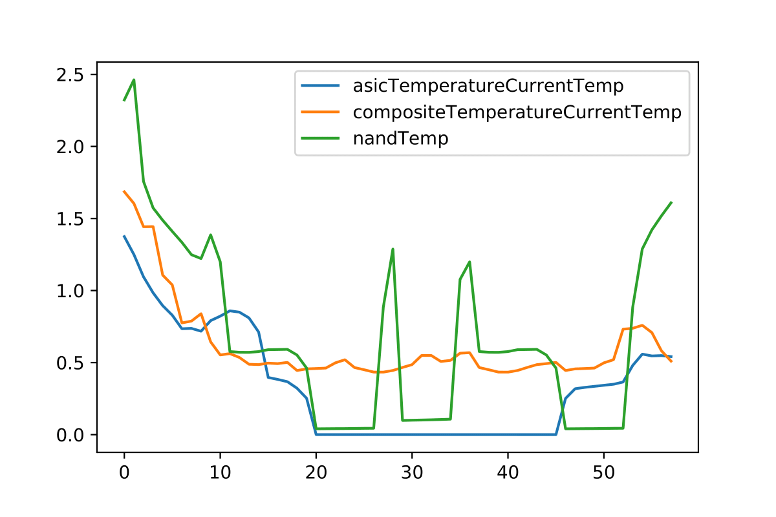
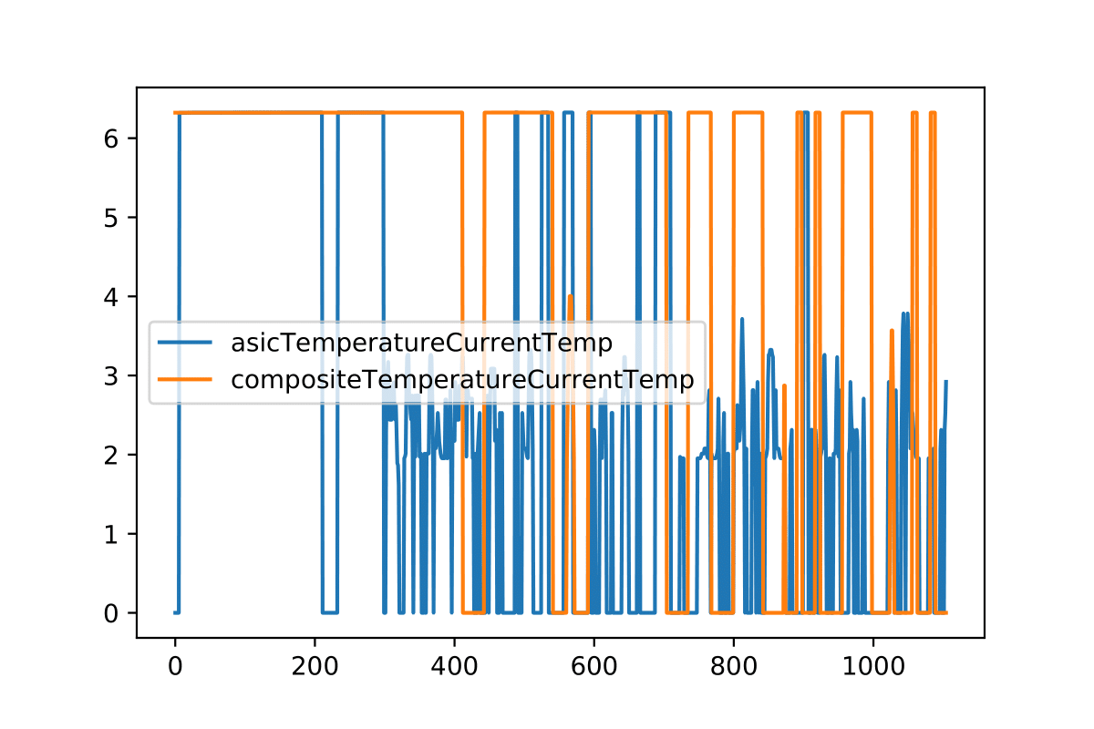
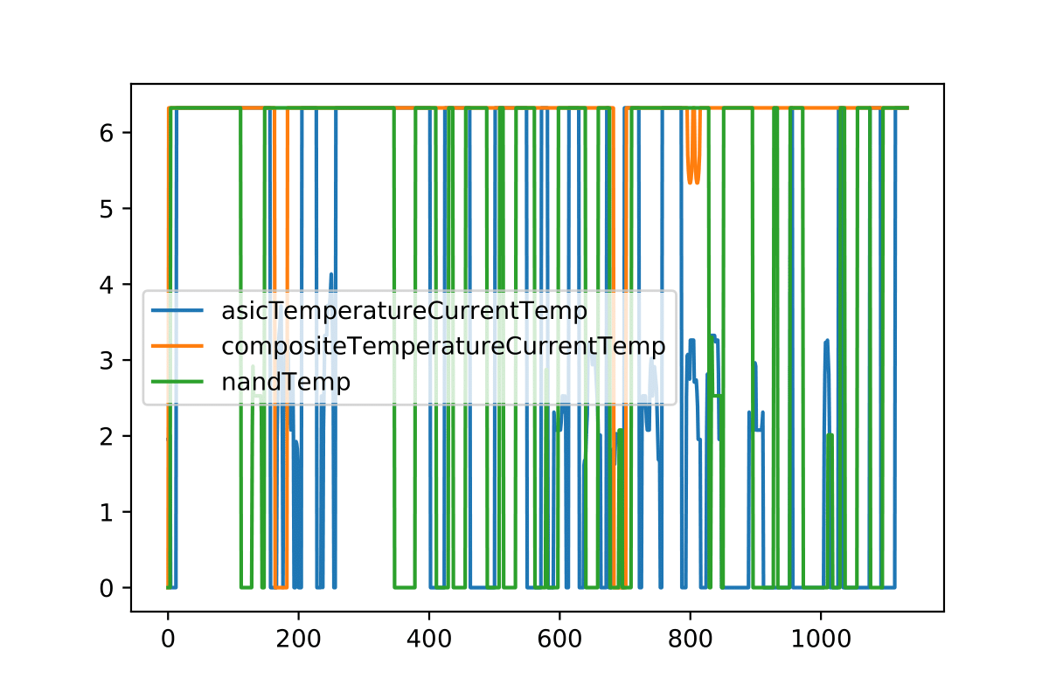

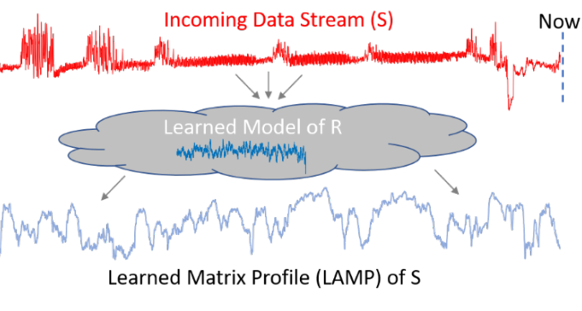
Example Results for Thermal Profile State Prediction
Create a heat map (similarity measure and cluster all profiles)
Train AI (ResNet), use AI to forecast next, cascade next(s), …, and long-term prediction
Additional profiles through inference improve accuracy
Probabilistic distributions model(s) the state and further increase prediction paths
Train AI Model(s)
ROC Prediction Verification
K-Map Compute Similarity for Prediction Model
Real-Time
State ED, PS, DTW | Fail - idle | Fail -Workload | Idle | Workload
Fail - idle | 0.0, 1.0, 0.0 | 20.0055, 0.989178, 29.0 | 621.523, 0.398262, 1347.0 | 662.066, 0.473512, 1645.0
Fail - Workload | 20.0055, 0.989178, 29.0 | 0.0, 1.0, 0.0 | 594.716, 0.356108 1576.0 | 634.753, 0.429385, 2534.0
Idle | 621.523, 0.398262, 1347.0 | 594.716, 0.356108, 1576.0 | 0.0, 1.0, 0.0 | 52.146, 0.380537, 744.0
Workload | 662.066, 0.473512, 1645.0 | 634.753, 0.429385, 2534.0 | 52.1461, 0.380537, 744.0 | 0.0, 1.0, 0.0
Forecast +1
92% Accuracy
for
predicting a
Thermal failures
Forecast …
Oracle
Notes:
The data profiles were then used to create a feature clustering of known states through various similarity search mechanism. The disjoint methods were choses from the most impactful research to cover and conduct a comprehensive approach. The data for profile similarity from on state to all others are shown in the table on the left hand side. The values are meant to be used by the machine programming and the coloring of the map shows the human visualization of similarity (green most similar, red non-similar). These features of the profile were then trained on a ResNet deep neural net to construct a baseline of state clusters. These state clusters were then expanded to use the entire time series to forecast the next time step in a cascading manner until we constructed a reasonable prediction window. The prediction window construction was trained from the data as well then tested on random data sets of the device to test the producibility accuracy. Based on our sample sets, we were able to show a 92% accuracy on prediction and we would like to extend the work to consume more data to further understand the production limitations.
The work was conducted with collaboration from universities investigating earthquake data with support from the national science foundation (NSF). The research shows promise as a tool to do learned approximate matrix profile prediction of SSD device state.
In collaboration with Dr. Eamonn Keogh (top ten most prolific author in SIGKDD, ICDM, SDM, and Data Mining and Knowledge Discovery).
Algorithms: Euclidian Distance (ED), Pearson's Correlations (PS), Dynamic Time Warping (DTW), LB-Keogh, UCR Suite, eDTW, Mueen's Algorithm For Similarly Search (MASS), Learned Approximate Matrix Profile, STOMP, STAMP, SCAMP, Dynamic Point Library, etc
Matrix Proﬁle XVIII: Time Series Mining in the Face of Fast Moving Streams using a Learned Approximate Matrix Profile. Zachary Zimmerman, Nader Shakibay Senobari, Gareth Funning, Evangelos Papalexakis, Samet Oymak, Philip Brisk, and Eamonn Keogh (2019). IEEE ICDM 2019.
Euclidian Distance (ED) – Direct distance
Pearson's Correlations (PS) – 0 to 1 correlation
Dynamic Time Warping (DTW) – Relative distance

Slide 39
Business Value
NSG’s Internal Value (scalability and efficiency)
Proposed Savings of this pathfinding:
Expert domain knowledge ramp reduced
Increased bug closure velocity
Ability to analyze, detect, predict, and mitigate anomalies
Influence Intel’s MP direction/capabilities
Notes:
With the pathfinding, we have reviewed the potential business value being:
Reduced domain ramp time,
Increased bug closure velocity
Ability to analyze detect, predict, and the potential for mitigation.
Lastly, the following builds on Intel’s direction for machine programming.

Slide 40
Strategic Value
Aligns with 2019 TSLRP Machine Programming and 2020 TSLRP submission.
Embraces host system driven identification of anomalies to amend and mitigate them in the future
Enables engineers with domain analysis modules to increase org velocity (automate expert output)
High velocity automated context feedback mechanisms to provide insight to compress timelines for earlier PRQs and enhanced pathfinding
Shifts mindset of experts to reflect on methods of analysis for feature creation
Continuous learning model ensures we can analyze our ecosystem in a rapid manner
Enables design weaknesses detection from expert driven Meta data analysis to:
Feed forward and back propagation enabled us leap into future architectures in shorter timeframes embracing reconfiguration
Strengthens patents we have in our proprietary telemetry through technological advances
Notes:
The High velocity automated context feedback mechanism(s) provide insight to compress timelines for earlier PRQs and enhanced pathfinding. When embrace host system, we can drive identification of anomalies to predict, amend, and mitigate these in the future. The research and development enables detection of design weaknesses from expert driven Meta data analysis. The consequence is a leap into future architectures in shorter timeframes embracing reconfiguration. The R&D further solidifies our patents and propriety technology to best execute on Intel.

Slide 41
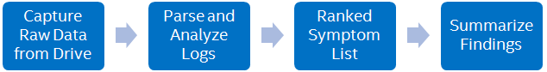
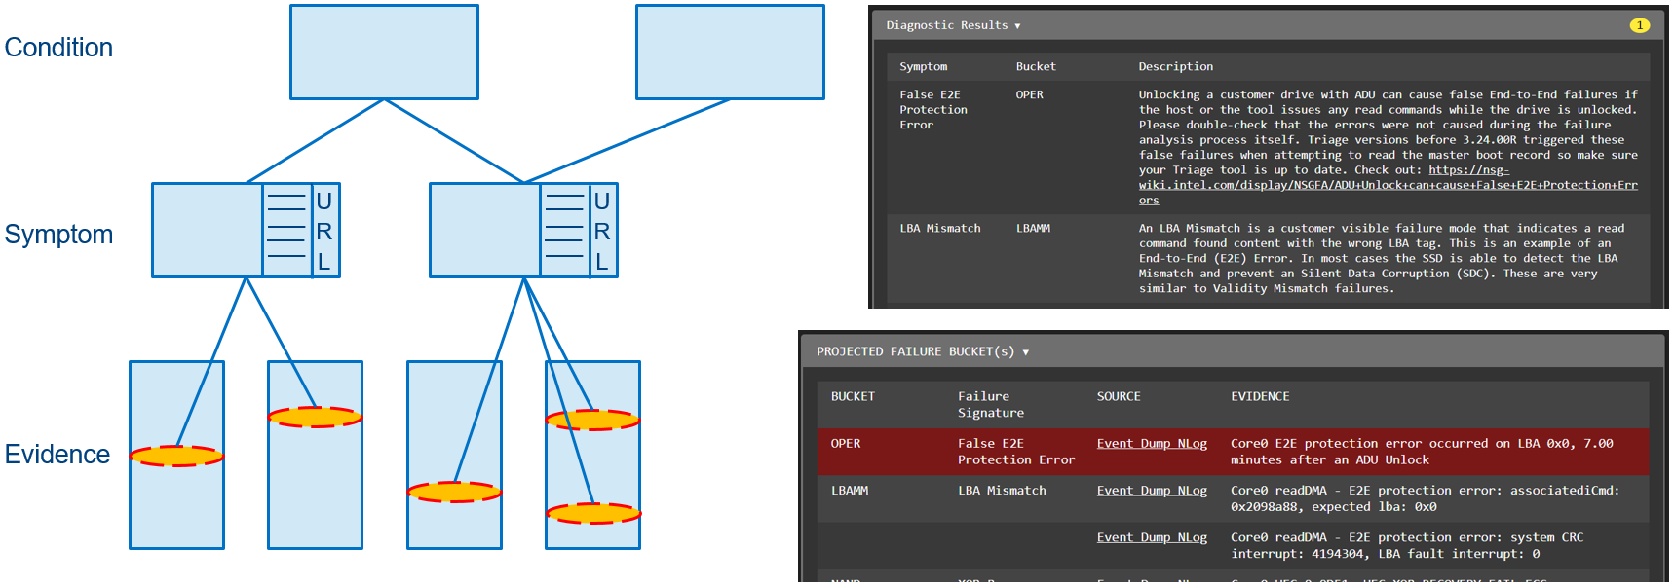

Customer Value
How would this idea provide value to our customers? What use case(s) would it improve?
Rapid analysis: Enables Intel to provide swift responses to product anomalies and inquiries about new features
Behavior Analysis: Provides host with ability to detect and predict anomalies through intelligent design.
Automated Anomalies Analysis Process
Notes:
When expanding to customers, we open the abilities to rapidly analyze data and behaviors on site with potential to predict these in the process for a robust and intelligent design. The automation flow shows the flow we have developed to enhance our triage tool.

Slide 42
Run Cross-Org Collaboration Team
Comprised of:
NSG, CCG, DCG, Intel Labs (IL), Intel’s Architecture Graphics and Software (IAGS), IT, Lehiegh University
Gottschlich, Justin justin.gottschlich@intel.com (25% + Team 50%)
Carruthers, Kathryn J kathryn.j.carruthers@intel.com
Gourley, James james.gourley@intel.com
Miao, Kai X kai.x.miao@intel.com
Manda, Jayaram jayaram.manda@intel.com
Chebiyam, Sunil sunil.chebiyam@intel.com
Innecco, Carlos carlos.innecco@intel.com
Hilliker, Josh josh.hilliker@intel.com
Alt, Samantha samantha.alt@intel.com
Casmira, Jason P jason.p.casmira@intel.com
Tran, Phuong P phuong.p.tran@intel.com
Eike, Randal randal.eike@intel.com
Sainz, Andrew F andrew.f.sainz@intel.com (25%)
Sanchez, Alberto G alberto.g.sanchez@intel.com
Habibelahian, Abbas A abbas.a.habibelahian@intel.com
Mehta, Sarika K sarika.k.mehta@intel.com
Ray, Madhurima Madhurima.Ray@intel.com
External Collaborators
Notes:
The collaborators expected to be inputters and co-travelers are across various BUs to align on the most sustainable direction for all of Intel.

Slide 43
References
Git
https://review.gerrithub.io/c/spdk/spdk/+/425191/
https://github.com/linux-nvme/nvme-cli
Matrix Profile, Prediction, Dynamic Point, and Optimizations
Extra
http://files.opencompute.org/oc/public.php?service=files&t=3963328530485f6e5944ba7ce4d1f8e3&download&path=/OCP%20-%20Adding%20Analytical%20Behavioral%20Intelligence%20to%20the%20Block%20Storage%20Lay....pdf
https://spdk.io/summit/us/2019/
https://www.cloudfest.com/wp-content/uploads/2018/03/01_Intel_CloudFest-Keynote-Das-Final.pdf?x86823
Article
https://itpeernetwork.intel.com/collect-or-not-collect/#gs.d2zakl
https://itpeernetwork.intel.com/telemetry-enhancing-customer-triage/
https://www.nvmedeveloperdays.com/English/Collaterals/Proceedings/2018/20181204_PRECON2_Hands.pdf
https://blogs.gnome.org/hughsie/2018/08/17/nvme-firmware-i-need-your-data/
https://lore.kernel.org/patchwork/patch/1072774/
https://manpages.debian.org/testing/nvme-cli/nvme.1.en.html
https://blocksandfiles.com/2019/08/02/burlywood-ssds-customised-workloadssd/
https://blogs.vmware.com/virtualblocks/2018/08/20/nvme-readiness-part-three/
https://www.supermicro.com/en/solutions/srsd
https://eric-keller.github.io/thesis/OliverMichel-dissertation_4_2019.pdf
https://arxiv.org/pdf/1803.07244.pdf
Notes:
On this slide, we have several references to the influential work within and around our BU.

Slide 44
Evaluation(s) of MP for NSG
Turing test(s) of External Behavior(s)
Recognition of Data
Method(s) Selection from Handbook
Generic tasks – Data handling
Broad - Developer
Specific – Expert
Automated Reasoning
Aggregation of data
Rank ordering of fault(s) areas
Congruence, induction, contradiction assessments
ML Measures (Standard Technique(s) for field)
Precision, Recall, ROC curve
Fault Code
Code decoded accurately
Data structures
Object(s), Data logs
Firmware Modules
Domains within the interactions
Intent
Known causes
Hypothesis
François Chollet. On the Measure of Intelligence. 2019. https://arxiv.org/abs/1911.01547 https://developers.google.com/machine-learning/crash-course/classification/precision-and-recall
https://developers.google.com/machine-learning/crash-course/classification/roc-and-auc
Notes:
https://arxiv.org/pdf/1911.01547.pdf
An ROC curve (receiver operating characteristic curve) is a graph showing the performance of a classification model at all classification thresholds. This curve plots two parameters: True Positive Rate and False Positive Rate. False negatives are the compliment function of false positive rate.

Slide 45
Data Control Measures
Methodology, best known method(s) (BKMs), and protocols.
In existence today, architected by Joe Tarango.
Documentation in Wiki page(s) and source code.

Slide 46
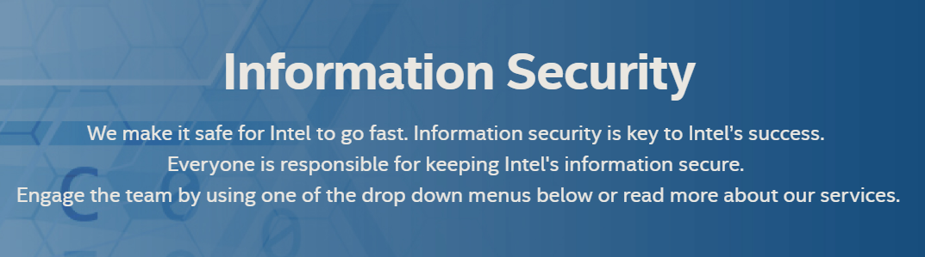
Security Data Classification
Guidelines - https://employeecontent.intel.com/content/corp/infosec/policies.html
Documentation - tools\telemetry\documentation
Security Risk Types
Data exposed to customers or the world.
Sensitive data relates to Intel secret or IP not protected by patent
Data object explanation
Each data structure should have a brief for the entire item and each element will need to be explained.
We need to list the units for each of the items with the base number I.E. base 2, base 10 mathematics, seconds.
Persistence type as defined by ePersistence in datacontrol.h I.E. constant, critical, lossly, reconstructed, etc.
NSG specific security context information
Security context information for the RNG/DRBG data. This includes ANY of the entropy data, DRBG internal data structures, etc.
Any of the firmware implemented algorithms such as CTR-DRBG
Any structure containing a user data payload with relation to admin commands, specifically security send a receive
I.E. DMT has an scx for SR so there the keys to the castle are there.
All key material data structures related to:
Fuse data containing things like the root key
PSID
Opal Passwords
UART passwords
TCG technology family (Opal, eSSC, Pyrite, etc.)
ATA security
Ephemeral keys
Plaintext keys in DRAM
https://employeecontent.intel.com/content/corp/infosec/home.html

Slide 47
Telemetry Data Addition Control Process
Review Security Guidelines for Data Control
Determine if the data meets the guidelines
Contact: Jim Baca, Randal Eike, Joe Tarango, Gamil Cain
Schedule Telemetry Working Group Meeting
Presentation
Usage Development and/or Business requisite
Review Control/Data Flow (C/DFG) and Data of the Object Desired
Showcase the usage and impact
Provide urgency of deployment and stakeholders
Timeline for internal and/or external release
Domain Reviewers
Allocate eUID to Sync Across products
Verify telemetry swim lane functionality and auto generation parser functionality with trackable tidbits link
Allocate Time
Live code review
Data extraction demonstration by walking through the C/DFG code path in Debugger
Request Code Promotion
Once code pushed, dispatch notification to stakeholders

Slide 48
Data Security Audit Process
Data Extraction
Method to access command to gather all secure data bytes and definitions
Similarity Search Audit Verification
All pairs compare of object bytes of secure data sets to telemetry payloads
Input: All security Data, Telemetry
Output: Grade of likely-hood we have leaked information
ConVal
Each product executes a swim lane to verify content does not escape
Release Checkpoint
Review detections over configuration similar require DRB presentation from product security lead to domain forum.

Slide 49
Telemetry Data Addition Control Process
Review Security Guidelines for Data Control
Determine if the data meets the guidelines
Contact: Jim Baca, Randal Eike, Joe Tarango, Gamil Cain
Schedule Telemetry Working Group Meeting
Presentation
Usage Development and/or Business requisite
Review Control/Data Flow (C/DFG) and Data of the Object Desired
Showcase the usage and impact
Provide urgency of deployment and stakeholders
Timeline for internal and/or external release
Domain Reviewers
Allocate eUID to Sync Across products
Verify telemetry swim lane functionality and auto generation parser functionality with trackable tidbits link
Allocate Time
Live code review
Data extraction demonstration by walking through the C/DFG code path in Debugger
Request Code Promotion
Once code pushed, dispatch notification to stakeholders

Slide 50
Fault Analysis Process and Template
All within Telemetry documentation and training.

Slide 51
BKM for Exit Criteria on Fault Analysis
Complete Debug Template
Empty_Template_v1.docx
Example_Template_v1.docx
Review with TPL, Team, and/or Domain
Post results within JIRA clearly and concisely
Add content to debug wiki handbook

Slide 52
Example Fault Condition SR003
Evaluation Focal Points
Seen at Customer?
Yes
Assert Condition Looseness or Ambiguity?
Several cases cause the failure resulting in not a unique signature
Developer to do Analysis using “High Level Analysis Flow”
Problem: Condition is due to a pre-fetched address not accessible in the current operation mode
Known causes: 1) Address corruption from runtime memory regions such as stack, heap, or branch condition. 2) Memory failures such as uncorrectable in SPI XOR, SRAM, Registers, or DRAM, 3) Error Injection Internal Testing (Not Customer Visible)
Firmware Data Necessary for Analysis:
FSR (Fault Status Registers), FAR (Fault Address Register), IFSR (Instruction Fault Status Register)…
Firmware Software Prevention:
Code coverage analysis and execution coverage for conditions
ASIC-Hardware Components
Rigorous screening of systems, Execution of all known state usage, Environment Stress Testing
Catastrophic Event leading to an Annual Failure Rate (AFR) post Reliability Demonstration Testing (RDT)?
Yes, since the failure is in code quality or hardware
Brown out or Power Loss Immanent (PLI) deadlock exposure?
Yes, SoC comes to a complete halt
Silent data error (SDE) or data miss-compare exposure?
Yes, control flow data for active data is to be marked un-recoverable
Granularity of potential exposure to Silent Data Error Rate (SDER)?
Yes, if recovery mechanism is in firmware then the recovery flow could lose critical data since the address could have been either local or gradual
Notes:
Joe
Firmware Data Necessary for Analysis:
FSR (Fault Status Registers), FAR (Fault Address Register), IFSR (Instruction Fault Status Register), IFAR (Instruction Fault Address Register), DFSR (Data Fault Status Register), DFAR (Data Fault Address Register), ADFSR (Auxiliary Data Fault Status Register), AIFSR (Auxiliary Instruction Fault Status Register), Data abort address, ASIC and/or Component Memory registers of Fault memory map region

